Slide 1
An example of setup and demo for Automated Fulfillment Network (AFN) in a network zone consortia
Yoel Kortick
Senior Librarian

Slide 2

Agenda
The environment and setup
The flow
Regarding the “Alma Network Holdings”

Slide 3
The environment and setup

Slide 4

Demo Environment Network Zone Consortia
In our example we have a network zone …
Network Zone institution
And three member institutions
Member institution
‘Alma University’
Member institution
‘Open University’
Member institution
‘University of Knowledge’

Slide 5
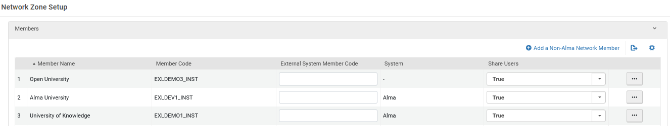
Shared Users
In the network zone we have defined “Shared Users”.
This can be seen by logging into the network zone and doing “Configuration > General > Collaborative Networks > Network Zone Setup”
We see the value “True” in the “Shared Users” column
For additional information see Centrally Managing Users in a Network Zone

Slide 6
Shared Users automatic creation
Currently we have defined that a user account will not automatically get created in the institution which holds the item which is getting requested by the patron from another institution.
More about this later as we show the flow.
In each of the three members we have defined the parameter uresolver_remote_register to have value ‘None’
This is defined at Configuration > Fulfillment > General > Other Settings
For additional information about this parameter see Fulfillment Networks

Slide 7
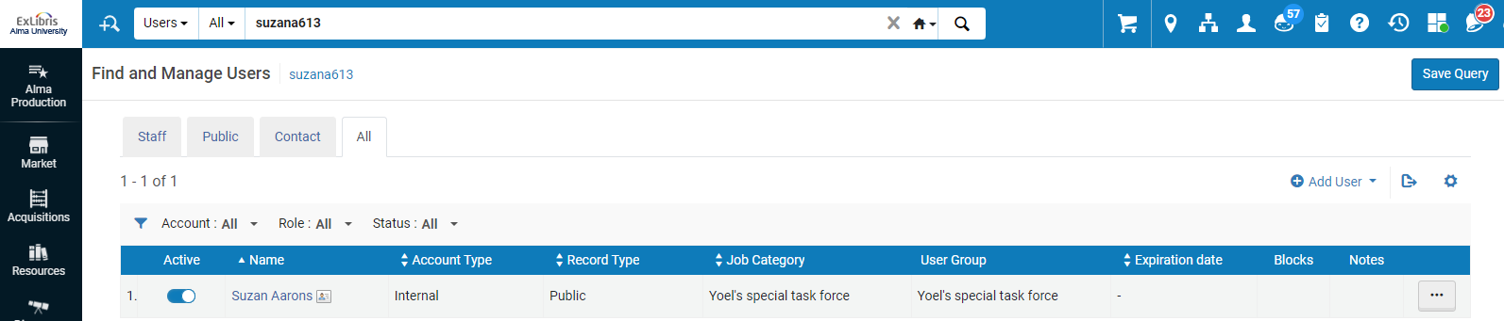
Sample User
The sample user is “Suzan Aarons” primary identifier SuzanA613. She exists in the member Alma University.

Slide 8
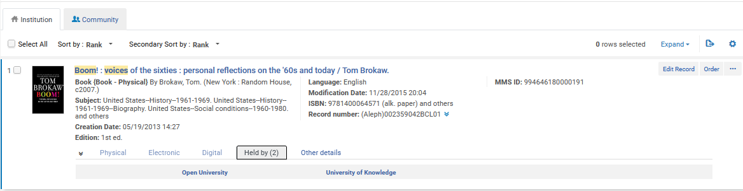
The sample title
Title “Boom! : voices of the sixties : personal reflections on the '60s and today” is held by “Open University” and “University of Knowledge”. It is not held by Alma University. Here is the record as viewed from the Network Zone Alma repository search

Slide 9
The flow

Slide 10
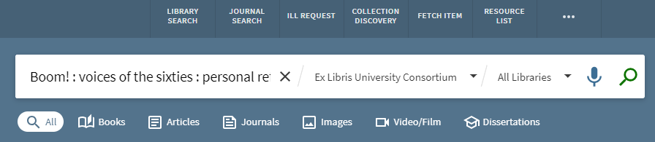
The flow – 1 – end user searches
User logs into Alma University Primo and searches the view “Ex Libris University Consortium”.
This is a view of the entire network zone.
User searches for above title “Boom! : voices of the sixties : personal reflections on the '60s and today”.

Slide 11
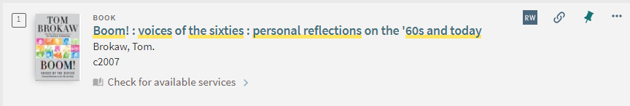
The flow – 2 – end user checks availability
User sees that the item is not available in her institution but can click “Check for available services”

Slide 12
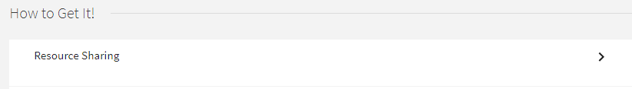
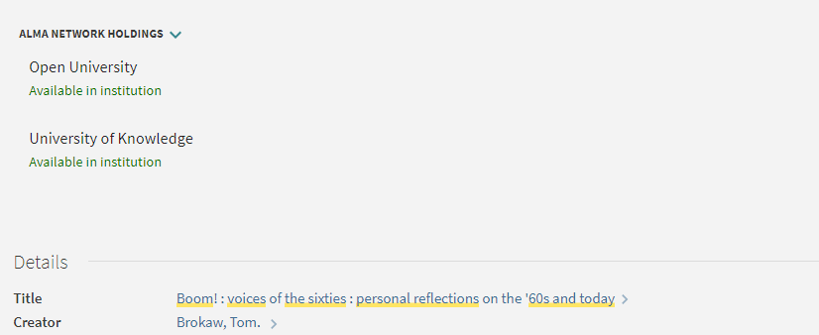
The flow – 3 – end user has resource sharing link
After clicking “Check for available services” the user sees option to request item via ‘Resource Sharing” and no need to log into another institution or click anywhere else.
This label can be renamed if desired.

Slide 13
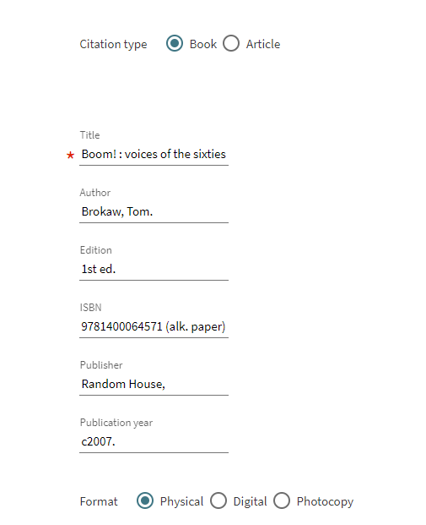
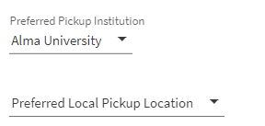
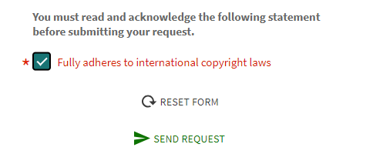
The flow – 4 – create resource sharing request
After clicking “Resource Sharing” everything is filled in and the user simply needs to send the request
The patron can choose which institution to pick up the item at, and by default it is the institution where he or she is registered

Slide 14
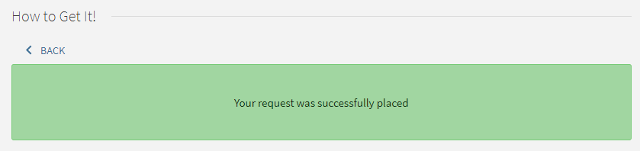
The flow – 5 – resource sharing request is created
The resource sharing request is created.

Slide 15
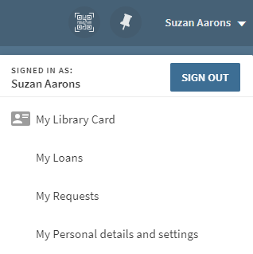
The flow – 6a – Patron can view resource sharing request

Slide 16
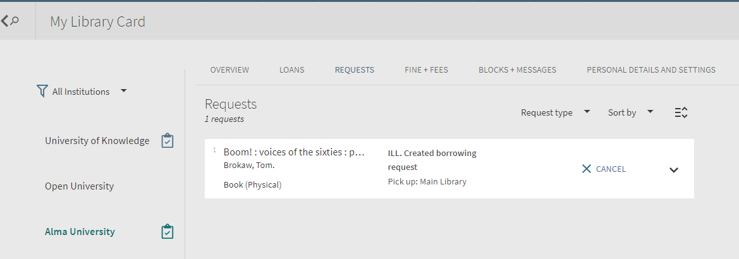
The flow – 6b – Patron can view resource sharing request

Slide 17
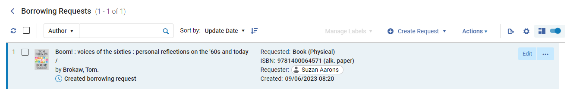
The flow – 7 – Staff user sees resource sharing request
The staff user in Alma University sees the request in the borrowing requests task list:
Now the borrowing request will go through the “regular flow”.

Slide 18
Regarding the “Alma Network Holdings”

Slide 19
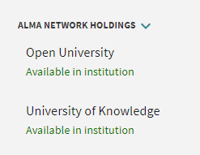
Regarding the “Alma Network Holdings”
Regarding the following, which appears after clicking “Check Available Services”

Slide 20
Regarding the “Alma Network Holdings”
There is a configuration option to “lock” this so that it will appear, but the user will not be able to click anything to “open” it and view more information.
If it is clickable, then the user will be able to see details of the inventory at the other member institution.
If the user does already exist in the other member institution, then he or she will also see a “request” option in the GetIt after clicking the specific institution.
  Above we stated uresolver_remote_register = None and therefore a user does not automatically get created in the institution that holds the inventory.

